Slide 1
Sorpe & Mohne by William

Slide 2
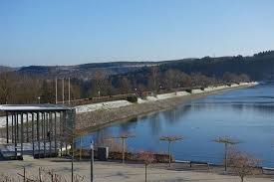
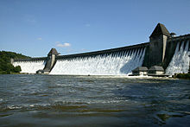
Sorpe & Mohne
It was built in 1926 This dam was built in 1913
It opened in 1935 And this dam had a
museum
Located 45Km east of Dortmand in Germany
Located near Sundern in Germany

Slide 3
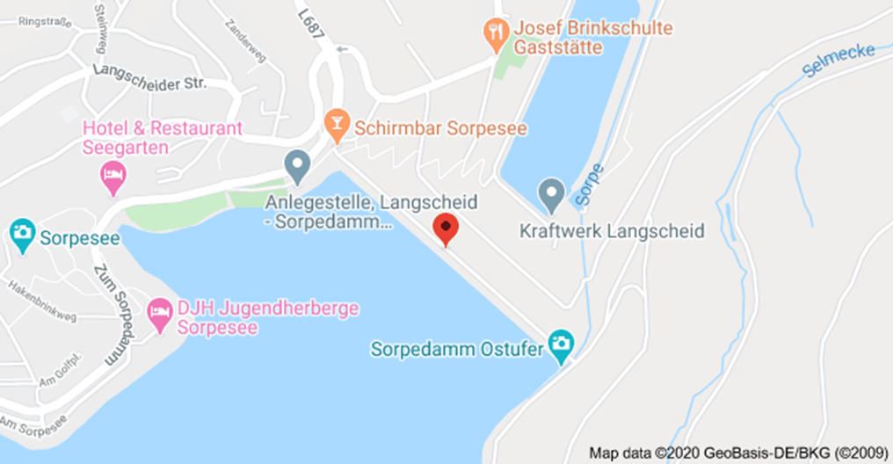
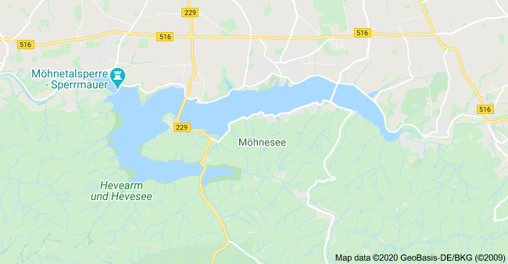
Sorpe & Mohne
Located near Sundern in Germany
Located 45Km east of Dortmand in Germany

Slide 4
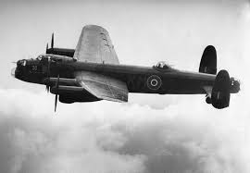
World war II target of air strikes
RAF Lancaster bomber planes were used.

Slide 5
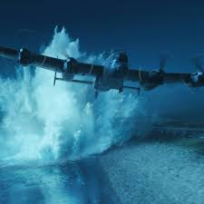
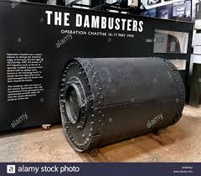
Operation Chastise
In the night of 16th May 1943.
Used bouncing bombs.

Slide 6
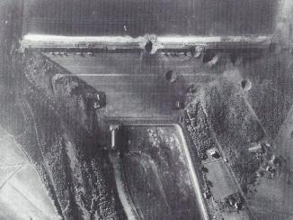
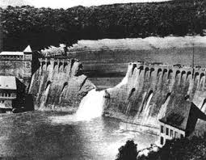
Sorpe Damage & Mohne Damage
Direct hit but hole was above
the waterline.
Damaged causing flooding with a hole 77m by 22m.

Slide 7
Eder

Slide 8
Ennepe dam

