Slide 1
Rosa DAM BUSTERS
Who were they?
The aircraft used in the raid were the iconic Lancaster Bombers. 19 were used in the mission, but only 11 returned, with 53 deaths incurred. One lesser known fact is that the planes had to fly exceptionally low to deliver their heavy, unwieldy cargo.

Slide 2
The weapon
Lancaster bombers dropped bouncing bombs that were invented by Barnes Wallis .The bombs bounced on the surface of the water(they had to be dropped at 60 Ft otherwise it would not work). It would then descend below the waves to the base of the dam. The bouncing bomb then exploded . But it often didn’t break the dam until the third attempt .

Slide 3
THE RESON FOR THE DAM BUSTERS
The Möhne dam in Germany's Ruhr valley secured the water supply for much of the surrounding area. Water from its reservoir was also used to generate electricity. It was thought that destruction of this dam and others in the region would cause massive disruption to German war production.

Slide 4
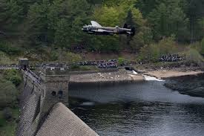
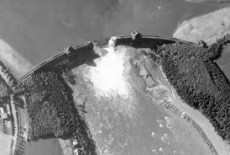
pictures

