Slide 1
DAMBUSTERS by Niusha

Slide 2
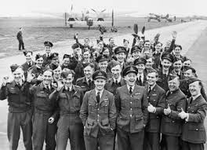
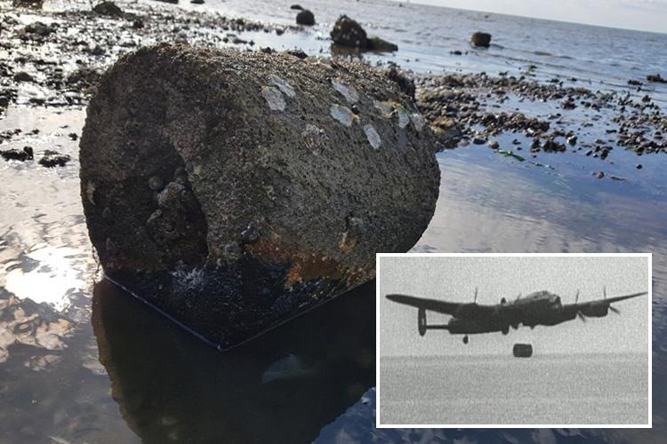
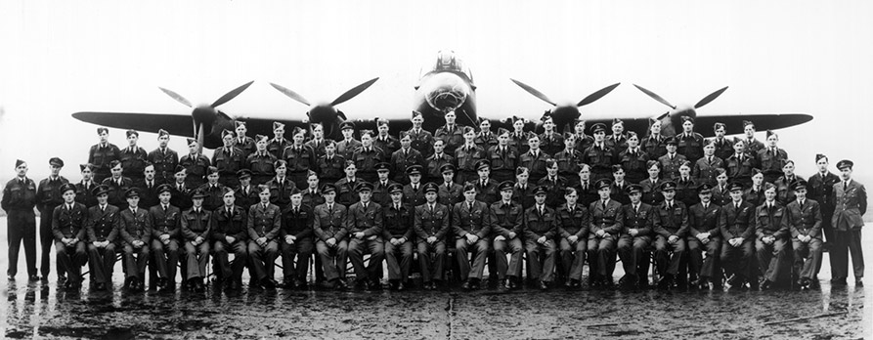
Some pictures
HERE IS A BOUNCING BOMB FOUND FROM FATHER AND SON –IN HERNBAY-

Slide 3
Dambusters
Operation Chastise was an attack on German dams carried out on 16–17 May 1943 by Royal Air Force No. 617 Squadron, later called the Dam Busters, using a purpose-built "bouncing bomb2 developed by Barnes Wallis. The Möhne and Edersee dams were breached, causing catastrophic flooding of the Ruhr valley and of villages in the Eder valley; the Sorpe Dam sustained only minor damage. Two hydroelectric power stations were destroyed and several more damaged. Factories and mines were also damaged and destroyed. An estimated 1,600 civilians – about 600 Germans and 1,000 mainly Soviet forced labourers – died. Despite rapid repairs by the Germans, production did not return to normal until S

Slide 4
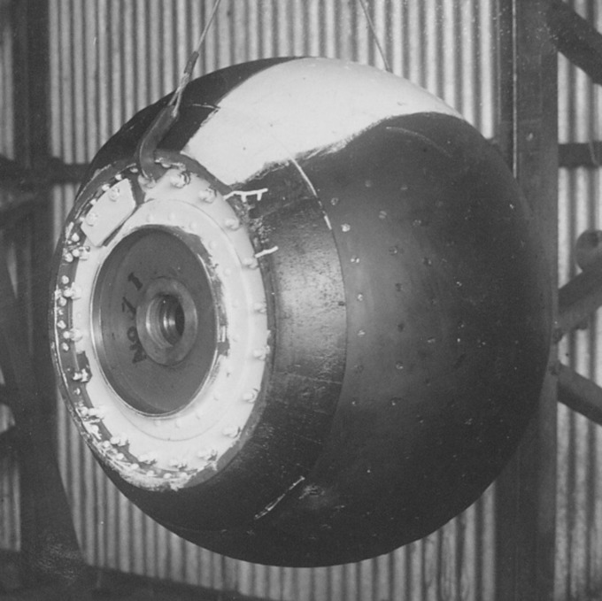
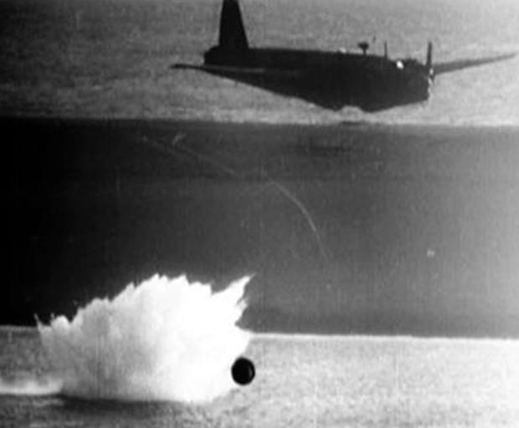
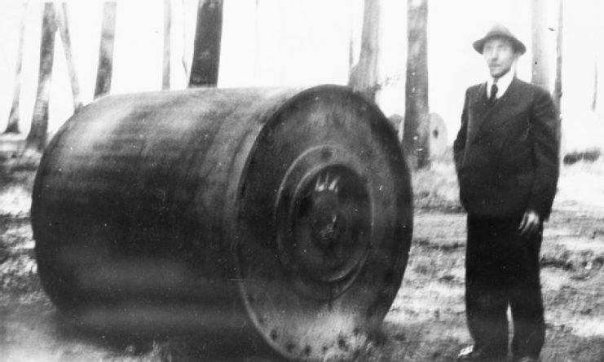
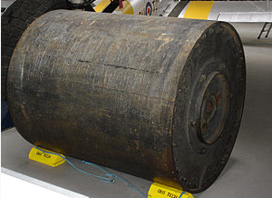
Bouncing bomb

Slide 5
Barnes wallis
Sir Barnes Neville Wallis (26 September 1887 – 30 October 1979), was an English scientist, engineer and inventor. He is best known for inventing the bouncing bomb .
The raid was the subject of the 1955 film The Dam Busters, in which Wallis was played by Michael Redgrave. Among his other inventions were his version of the geodetic airframe
and the earthquake bomb.

Slide 6
Guy Gibson
Wing Commander Guy Penrose Gibson, VC, DSO & Bar, DFC & Bar (12 August 1918 – 19 September 1944) was a distinguished bomber pilot in the Royal Air Force during the Second World War. He was the first Commanding Officer of No. 617 Squadron, which he led in the "Dam Busters" raid in 1943, resulting in the breaching of two large dams in the Ruhr area of Germany. He was awarded the Victoria Cross, the highest award for gallantry in the face of the enemy that can be awarded to British and Commonwealth forces, in the aftermath of the raid in May 1943 and became the most highly decorated British serviceman at that time.^{[2]} He completed over 170 war operations before dying in action at the age of 26.

Slide 7
Dambusters
Operation Chastise was an attack on German dams carried out on 16–17 May 1943 by Royal Air Force No. 617 Squadron, later called the Dam Busters, using a purpose-built "bouncing bomb" developed by Barnes Wallis. The Möhne and Edersee dams were breached, causing catastrophic flooding of the Ruhr valley and of villages in the Eder valley; the Sorpe Dam sustained only minor damage. Two hydroelectric power stations were destroyed and several more damaged. Factories and mines were also damaged and destroyed. An estimated 1,600 civilians – about 600 Germans and 1,000 mainly Soviet forced labourers – died. Despite rapid repairs by the Germans, production did not return to normal until September.

