Slide 1
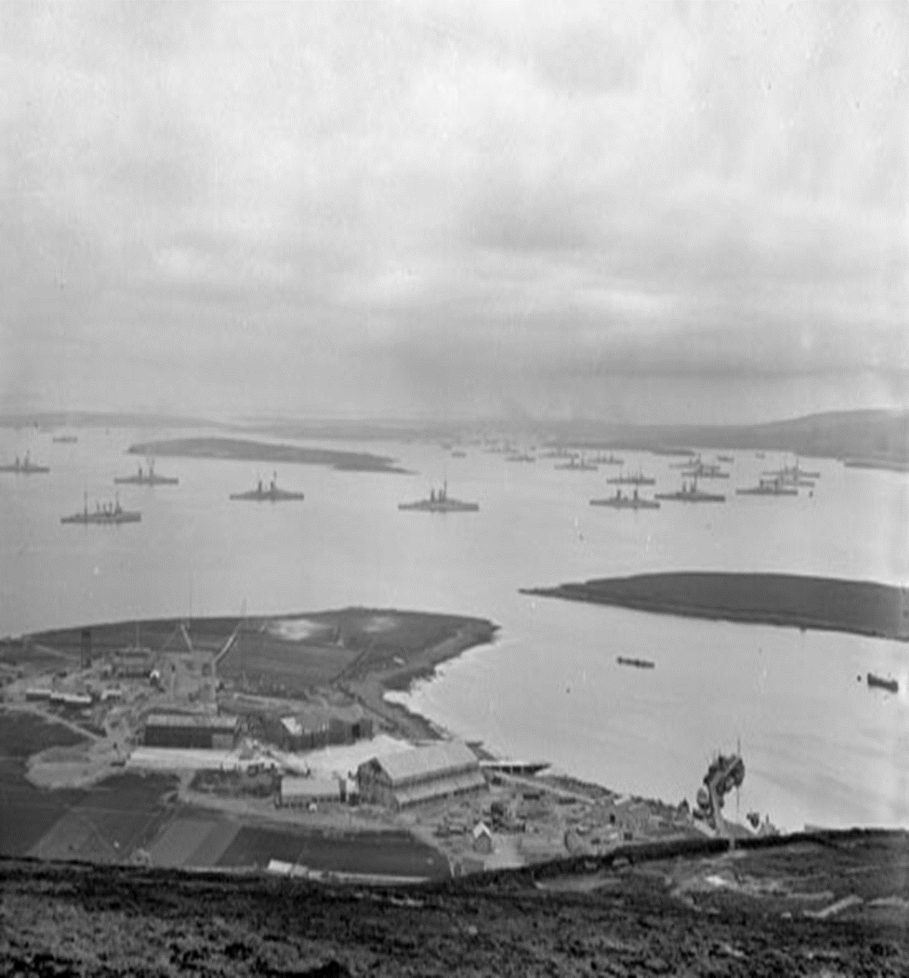
How was Orkney Vital to The British and Allied War Effort?

